Slide 1
Randomized Blinded Sham- and Waitlist-Controlled Trial of Acupuncture for Joint Symptoms Related to Aromatase Inhibitors in Women with Early Stage Breast Cancer (SWOG 1200)
San Antonio Breast Cancer Symposium, December 5-9, 2017
Dawn L. Hershman, Joseph M. Unger, Heather Greenlee, Jillian Capodice, Danika L. Lew, Amy Darke, Alice Kengla, Marianne K. Melnik, Carla W. Jorgensen, William H. Kreisle, Lori M. Minasian, Michael J. Fisch, N. Lynn Henry, Katherine D. Crew
This presentation is the intellectual property of the presenter. Contact her at dlh23@columbia.edu for permission to reprint and/or distribute.

Slide 2
BACKGROUND
San Antonio Breast Cancer Symposium, December 5-9, 2017
Despite the efficacy of aromatase inhibitors, many patients suffer from joint side effects > leading to non-compliance.
Compliance to AI’s is associated with improved disease-free survival.
Acupuncture is a popular non-pharmacologic modality for the treatment of a variety of medical conditions.
Several small studies have suggested acupuncture may be beneficial for AI-arthralgias; however others have shown no benefit.
Hershman, DL. JCO,2008
Chrigwin. JH. JCO, 2016
Crew, KD. JCO, 2010
This presentation is the intellectual property of the presenter. Contact her at dlh23@columbia.edu for permission to reprint and/or distribute.

Slide 3
STUDY DESIGN
San Antonio Breast Cancer Symposium, December 5-9, 2017
AI
> 3/10 Worst Pain
N=226
True Acupuncture
2x week x 6 weeks
Wait List Control
6 weeks
Wait List Control
6 weeks
Sham Acupuncture
2x week x 6 weeks
Sham Acupuncture
1x week x 6 weeks
True Acupuncture
1x week x 6 weeks
No Acupuncture
12 weeks
No Acupuncture
12 weeks
Wait List Control
12 weeks
PRIMARY ENDPOINT
2
1
1
Assessment Week
0
6
12
24
This presentation is the intellectual property of the presenter. Contact her at dlh23@columbia.edu for permission to reprint and/or distribute.

Slide 4
ELIGIBILITY
San Antonio Breast Cancer Symposium, December 5-9, 2017
Stage 1-3 hormone sensitive breast cancer
Third-generation AI for at least 30 days prior to registration
Score of >3 (range, 0-10) on the worst pain item of the BPI
Symptoms started or increased since starting AI
No opioids or corticosteroid and no alternative/physical therapy for the treatment of joint pain within 28 days prior to registration
No prior acupuncture treatment for joint symptoms at any time, but allowed for other reasons >12 months prior
This presentation is the intellectual property of the presenter. Contact her at dlh23@columbia.edu for permission to reprint and/or distribute.

Slide 5
INTERVENTION
San Antonio Breast Cancer Symposium, December 5-9, 2017
True Acupuncture
Standard Traditional Chinese Medicine point prescription to reduce pain and decrease stress (30-45 min per session)
Full body, auricular and joint-specific acupuncture protocol tailored to the most painful joints
Sham Acupuncture
Shallow needle insertion utilizing thin and short needles at non-acupuncture points
Four standardized points, auricular sham and joint-specific sham point protocols within the proximity of the specified anatomic area
Wait List Control
True acupuncture offered after 24 weeks
Crew, KD. JCO,2010
This presentation is the intellectual property of the presenter. Contact her at dlh23@columbia.edu for permission to reprint and/or distribute.

Slide 6
PATIENT CHARACTERISTICS
San Antonio Breast Cancer Symposium, December 5-9, 2017
 | Total (n=226) |  | True Acupuncture (n=110) |  | Sham Acupuncture (n=59) |  | Waitlist Control (n=57)
Age, years
Median | 60.7 |  | 60.8 |  | 57.0 |  | 60.6
Hispanic, N (%) | 21 | 7% | 11 | 10% | 7 | 12% | 3 | 5%
Race, N (%)
White | 193 | 88% | 88 | 83% | 54 | 93% | 51 | 91%
Black | 10 | 5% | 6 | 6% | 2 | 3% | 2 | 4%
Asian | 15 | 7% | 11 | 10% | 2 | 3% | 2 | 4%
Prior Chemotherapy, N (%) | 111 | 49% | 56 | 51% | 31 | 53% | 24 | 42%
AI Therapy (median yrs) | 1.1 |  | 1.0 |  | 1.1 |  | 1.1
Prior Acupuncture, N (%) | 44 | 19% | 19 | 17% | 13 | 22% | 12 | 21%
Baseline Score – BPI WP |  |  | 6.84 |  | 6.55 |  | 6.48
This presentation is the intellectual property of the presenter. Contact her at dlh23@columbia.edu for permission to reprint and/or distribute.

Slide 7
6-WEEK RESULTS - WORST PAIN (BPI)
San Antonio Breast Cancer Symposium, December 5-9, 2017
Percent with 2-point change
WORST PAIN | Fitted Difference* | P-value
True v. Sham | 0.92 (0.20-1.65) | .01
True v. Waitlist | 0.96 (0.24-1.67) | .01
Sham v. Waitlist | 0.05 (-0.81-0.90) | .92
* Corrected for baseline score and study site
This presentation is the intellectual property of the presenter. Contact her at dlh23@columbia.edu for permission to reprint and/or distribute.

Slide 8
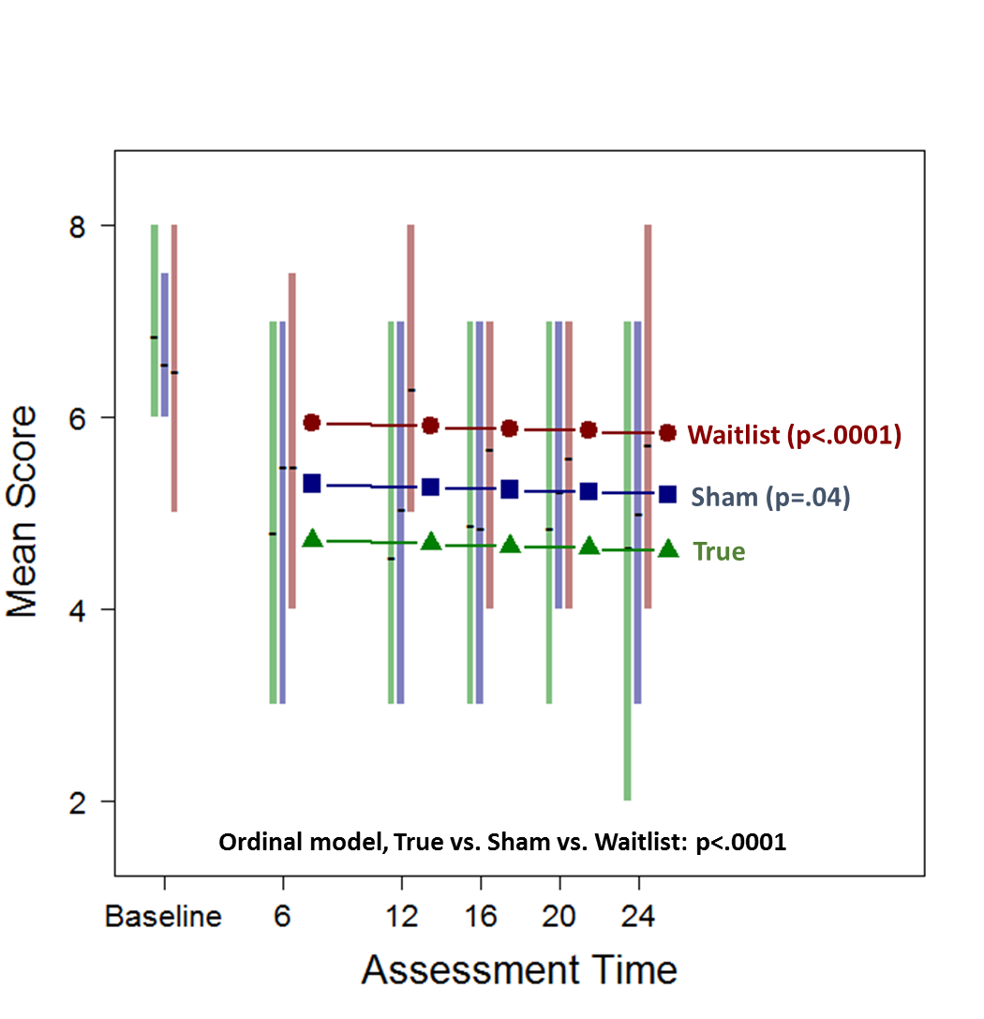
Linear Mixed Model - Worst Pain (BPI)
San Antonio Breast Cancer Symposium, December 5-9, 2017
This presentation is the intellectual property of the presenter. Contact her at dlh23@columbia.edu for permission to reprint and/or distribute.

Slide 9
RESULTS - Other 6 Week Endpoints
San Antonio Breast Cancer Symposium, December 5-9, 2017
BPI AVERAGE PAIN | Fitted Difference | P-value
True v. Sham | 0.60 (0.03, 1.17) | .04
True v. Waitlist | 0.71 (0.15, 1.28) | .01
Sham v. Waitlist | 0.08 (-0.51, 0.68) | .79
WOMAC | Fitted Difference | P-value
True v. Sham | 9.27 (3.73, 14.82) | .001
True v. Waitlist | 12.18 (6.76, 17.59) | <.0001
Sham v. Waitlist | 3.01 (-2.75, 8.78) | 0.31
BPI STIFFNESS | Fitted Difference | P-value
True v. Sham | 1.00 (0.19, 1.81) | .02
True v. Waitlist | 1.09 (0.26, 1.92) | .01
Sham v. Waitlist | 0.17 (-0.62, 0.96) | .67
M-SACRAH | Fitted Difference | P-value
True v. Sham | 6.23 (0.92, 11.55) | .02
True v. Waitlist | 9.40 (4.52, 14.28) | .0002
Sham v. Waitlist | 4.26 (-1.32, 9.84) | .14
This presentation is the intellectual property of the presenter. Contact her at dlh23@columbia.edu for permission to reprint and/or distribute.

Slide 10
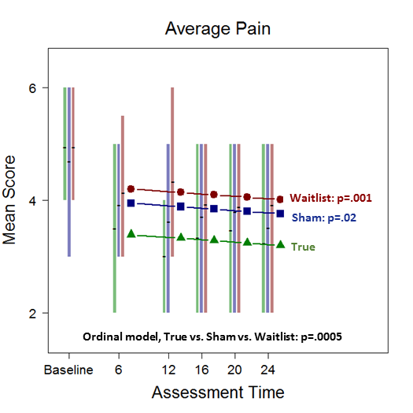
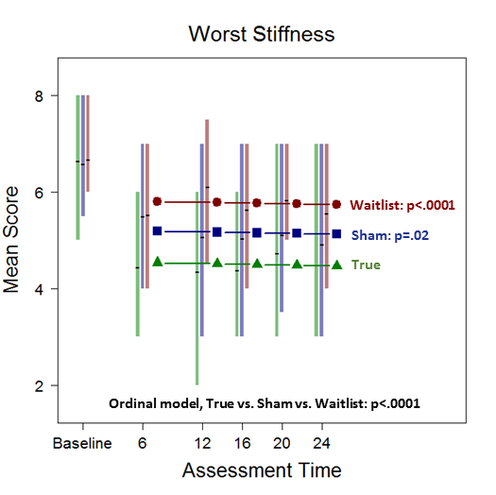
Linear Mixed Model: Other Endpoints
San Antonio Breast Cancer Symposium, December 5-9, 2017
This presentation is the intellectual property of the presenter. Contact her at dlh23@columbia.edu for permission to reprint and/or distribute.

Slide 11
ADVERSE EVENTS
San Antonio Breast Cancer Symposium, December 5-9, 2017
 | True Acupuncture (n=106) Grade |  |  |  | Sham Acupuncture (n=55) Grade
ADVERSE EVENTS | 0 | 1 | 2 | 3 | 0 | 1 | 2 | 3
Bruising | 56 | 50 | 0 | 0 | 41 | 14 | 0 | 0
Dizziness | 101 | 5 | 0 | 0 | 55 | 0 | 0 | 0
Ear pain | 105 | 1 | 0 | 0 | 54 | 1 | 0 | 0
Hematoma | 105 | 1 | 0 | 0 | 55 | 0 | 0 | 0
Bleeding at injection site | 103 | 3 | 0 | 0 | 53 | 2 | 0 | 0
Pain in extremity | 105 | 1 | 0 | 0 | 55 | 0 | 0 | 0
Presyncope | 105 | 0 | 1 | 0 | 54 | 0 | 1 | 0
Grade 1 bruising (47% vs. 25%) p=.01
This presentation is the intellectual property of the presenter. Contact her at dlh23@columbia.edu for permission to reprint and/or distribute.

Slide 12
CONCLUSIONS
San Antonio Breast Cancer Symposium, December 5-9, 2017
We have shown consistently, with multiple measures assessing pain and stiffness, that true acupuncture generated better outcomes than either control group in a large multicenter randomized controlled trial.
Transitioning from twice-a-week to once-a-week acupuncture maintained the effect of the intervention.
The intervention effects persisted 12 weeks following completion of the intervention.
The toxicity of the intervention was minimal and limited to grade 1 bruising.
This presentation is the intellectual property of the presenter. Contact her at dlh23@columbia.edu for permission to reprint and/or distribute.

Slide 13
CLINICAL IMPLICATIONS
San Antonio Breast Cancer Symposium, December 5-9, 2017
Acupuncture provides a non-pharmacologic option that can improve symptoms and possibly increase AI adherence + subsequent BC outcomes.
For patients reluctant to take a prescription medication, that can result in other side effects, acupuncture provides a safe and effective alternative.
Identification of non-opioid options for pain control is a public health priority.
The cost of the 12-week (18 session) intervention was ~ $1,250 ($65-$75/session) and we feel there is now sufficient evidence to support insurance coverage of acupuncture for AI arthralgia.
This presentation is the intellectual property of the presenter. Contact her at dlh23@columbia.edu for permission to reprint and/or distribute.

