Slide 1
NSABP B-47 (NRG Oncology) Phase III RCT Comparing Adjuvant Chemotherapy AC→Weekly Paclitaxel (WP) or TC x 6 with or without Trastuzumab for 1 Year in High-risk, Invasive Breast Cancer, Negative for HER2 by ISH and with IHC 1+ or 2+ (HER2-Low IBC)
San Antonio Breast Cancer Symposium, December 5-9, 2017
Louis Fehrenbacher, Reena S. Cecchini, Charles E. Geyer, Jr., Priya Rastogi,
Joseph P. Costantino, James N. Atkins, Jonathan Polikoff, Jean-Francois Boileau, Louise Provencher, Christopher Stokoe, Timothy D. Moore, André Robidoux, Virginia Borges, Kathy S. Albain, Sandra M. Swain, Soonmyung Paik, Eleftherios P.Mamounas, Norman Wolmark
This presentation is the intellectual property of the presenter. Contact them at Lou.Fehrenbacher@kp.org for permission to reprint and/or distribute
Notes:
I want to thank the educational committee for allowing me, on behalf of my co-investigators and NSABP/NRG, to present the results of NSABP B-47. The title describes the study. Read title.

Slide 2
Potential Conflict(s) of Interest Disclosures
San Antonio Breast Cancer Symposium, December 5-9, 2017
L Fehrenbacher: Contracted Research: Genentech/Roche, CellDex, Abbvie, Macrogenics, Cascadian, Pfizer; Study participation.
CE Geyer, Jr: Advisory Board: Myriad, Heron; Research funding: Merck; Travel expenses: AstraZeneca, Genentech. J-F Boileau: Fees for Non-CME Services Received from Commercial Interest/Agents: Roche - Preceptorship presentation; Contracted Research : Roche - Institutional PI for B-47 and KRISTINE trials; Other: Roche - Travel reimbursement to attend scientific meeting. L Provencher: Consulting Fees: Advisory Boards - Roche, Novartis. A Robidoux: Consulting Fees: Novartis, Pfizer, Genomic Health (GHI); Fees for Non-CME Services Received from Commercial Interest/Agents: GHI; Contracted Research: Novartis, Roche, Merck, AstraZeneca, Amgen. V Borges: Contracted Research: Merck, Abbvie, Cascadian Therapeutics, Biothera, Pfizer, Merrimack. KS Albain: Consulting Fees: Advisory Board - Genentech/Roche. SM Swain: Consulting Fees: Pieris Pharmaceuticals; Fees for Non-CME Services Received from Commercial Interest/Agents: Genentech/Roche, Novartis. EP Mamounas: Consulting Fees: Genentech/Roche; Fees for Non-CME Services Received from Commercial Interest/Agents: Genentech/Roche. All other authors declare no other potential conflicts of interest.
This presentation is the intellectual property of the presenter. Contact them at Lou.Fehrenbacher@kp.org for permission to reprint and/or distribute
Notes:
These are the listed Potential COI’s including sponsored study participation.

Slide 3
San Antonio Breast Cancer Symposium, December 5-9, 2017
ASCO 2005: B-31/N9831 HER2 3+ or FISH + >2.0
B-31
N9831
AC->T+H
AC->T+H
85%
AC->T
AC->T
%DFS
67%
N Events
N Events
AC->T 872 171
AC->T 807 90
AC->T+H 864 83
AC->T+H 808 51
HR=0.45, 2P=1x10⁻⁹
HR=0.55, 2P=0.0005
Years
Years
This presentation is the intellectual property of the presenter. Contact them at Lou.Fehrenbacher@kp.org for permission to reprint and/or distribute
Notes:
Many of you here today remember the excitement in 2005 when Dr. Romond presented the results of the combined analysis of NSABP B-31 and N9831 showing the dramatic improvement in DFS when trastuzumab was added to chemotherapy in HER2-positive breast cancer.

Slide 4
NSABP B-31; ASCO 2005
San Antonio Breast Cancer Symposium, December 5-9, 2017
AC→Paclitaxel with or without trastuzumab
HER2+ high risk breast cancer
Initial study entry criteria Included
FISH+ >2.0 or IHC 3+
HER2 testing performed at local lab site
A tissue specimen sent to NSABP for later testing
NSABP B-31: Central HER2 status performed on submitted tissue showed 9.7% were not HER2 IHC 3+ or FISH+ > 2.0
This presentation is the intellectual property of the presenter. Contact them at Lou.Fehrenbacher@kp.org for permission to reprint and/or distribute
Notes:
As a reminder, those studies defined HER2+ disease by a FISH result of >2.0 and or an IHC score of 3+. The qualifying HER2 testing was performed initially at a local lab. The NSABP initiated a central quality check on enrolled patients after 529 patients.

Slide 5
San Antonio Breast Cancer Symposium, December 5-9, 2017
Interaction p=0.60 for FISH
Interaction p=0.26 for IHC
Note: RR adjusted for ER and nodal status
This presentation is the intellectual property of the presenter. Contact them at Lou.Fehrenbacher@kp.org for permission to reprint and/or distribute
Notes:
When the B-31 population was analyzed by centrally-tested HER2 status, there was no relationship between trastuzumab benefit and HER2 status by FISH, or IHC, or the combination. Note the Hazard Ratio for the 174 centrally HER2-negative patients same as for FISH and IHC 3+.

Slide 6
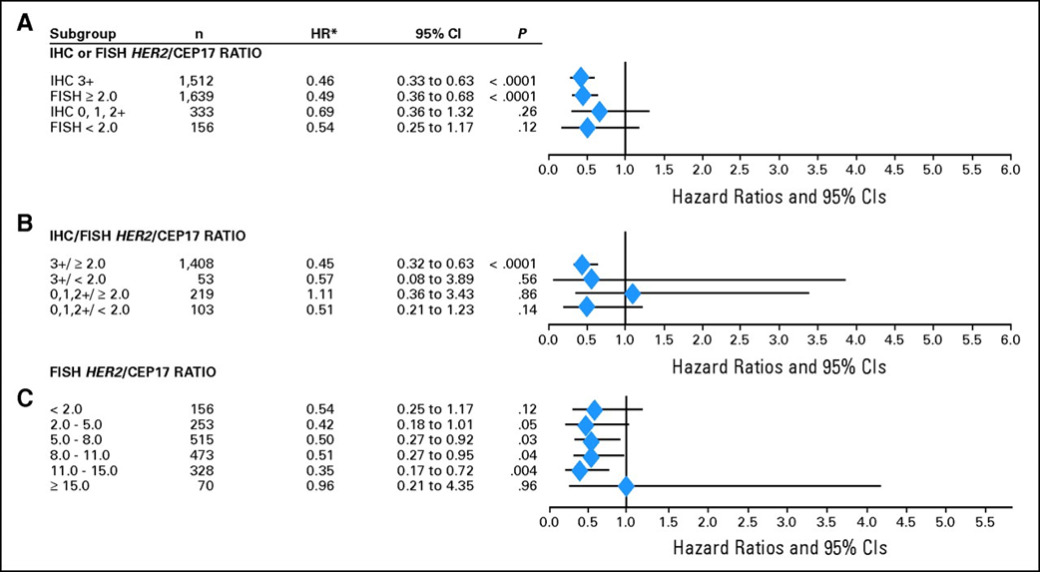
N9831 Outcomes by HER2 Status
San Antonio Breast Cancer Symposium, December 5-9, 2017
Perez EA, et al. J Clin Oncol. 2010;28:4307-15
This presentation is the intellectual property of the presenter. Contact them at Lou.Fehrenbacher@kp.org for permission to reprint and/or distribute
Notes:
Dr Perez published similar results showing a low HR for trastuzumab benefit in the 103 N9831 centrally HER2 negative patients.

Slide 7
San Antonio Breast Cancer Symposium, December 5-9, 2017
B-47: Adjuvant Trastuzumab in HER2 Low Breast Cancer
STRATIFICATION
HER2 IHC Score (1+, 2+)
Number of Positive Nodes (0-3, 4-9, 10+)
ER / PgR Status
Intended ChemoRx regimen (AC→WP, TC)
RANDOMIZATION
GROUP 1
ChemoRx*
GROUP 2
ChemoRx* +
Trastuzumab x 1year
Hormonal therapy and radiotherapy as indicated. Chemotherapy by MD Choice:
*AC→WP: Doxorubicin 60mg/m2 and Cyclophosphamide 600mg/m2 q2 or 3 wks x 4 followed by qwk paclitaxel x 12
or TC: Docetaxel 75mg/m2 + Cyclophosphamide 600mg/m2 q3wk x 6.
This presentation is the intellectual property of the presenter. Contact them at Lou.Fehrenbacher@kp.org for permission to reprint and/or distribute
Notes:
Because of these results, NSABP and NCI CTEP initiated B-47, A RCT of Chemorx with or without one year of trastuzumab. The stratification variables were as listed on this slide. The chemotherapy was of physician’s choice between AC WP and TC x 6. Trastuzumab was not given concurrently with doxorubicin.

Slide 8
San Antonio Breast Cancer Symposium, December 5-9, 2017
B-47: Study Population
Characteristic | N
Number randomized Number without follow-up Number with follow-up Accrual Jan 2011 to Feb 2015 Median follow-up time (months) | 3,270 63 (1.9%) 3,207 50 months 46.1 months
This presentation is the intellectual property of the presenter. Contact them at Lou.Fehrenbacher@kp.org for permission to reprint and/or distribute
Notes:
B-47 enrolled 3,270 patients from 2011 to 2015. Median follow-up at analysis was 46.1 months.
8

Slide 9
B-47: Invasive Disease-free Survival
San Antonio Breast Cancer Symposium, December 5-9, 2017
HR 0.98 (95% CI 0.77-1.26) P=0.90
Treatment N Events 5-year EFS
ChemoRx
ChemoRx+Trast
1603
1599
134 89.2%
130 89.6%
No. at Risk
ChemoRx
ChemoRx+Trast
1603
1599
1558
1528
1423
1403
1003
1009
595
591
140
117
This presentation is the intellectual property of the presenter. Contact them at Lou.Fehrenbacher@kp.org for permission to reprint and/or distribute
Notes:
There was absolutely no difference in IDFS between the two arms, with an HR of 0.98, a near-equal number of events, and a 5-year estimate of EFS of 89.2% for ChemoRx alone and 89.6% for ChemoRx and trastuzumab.

Slide 10
San Antonio Breast Cancer Symposium, December 5-9, 2017
B-47: IDFS by Stratification Variables
This presentation is the intellectual property of the presenter. Contact them at Lou.Fehrenbacher@kp.org for permission to reprint and/or distribute
Notes:
Here is the Forest Plot for the Stratification Variables. Note there is no outcome difference in any of the variables including IHC 2+, and there was no benefit trend seen.

Slide 11
Conclusions:
San Antonio Breast Cancer Symposium, December 5-9, 2017
The primary objective of improving IDFS was NOT met.
None of the secondary endpoints were met. No trends of efficacy were seen.
There was NO difference in outcomes for IHC 1+ or 2+.
Severe toxicities were infrequent, no new safety signal.
This presentation is the intellectual property of the presenter. Contact them at Lou.Fehrenbacher@kp.org for permission to reprint and/or distribute
Notes:
11
The primary objective of improving IDFS was NOT met.
None of the secondary objectives of OS, DFS, BCFS, RFI, and DRFI were met. No trends of efficacy were seen.
There was NO difference in outcomes for IHC 1+ or 2+.
Severe toxicities were infrequent and not appreciably increased with the addition of trastuzumab other than 1% increase in cardiotoxicity.

Slide 12
Conclusions (2)
San Antonio Breast Cancer Symposium, December 5-9, 2017
Patients in both arms did well with 5-year IDFS of 89.2 to 89.6%.
The retrospective outcome differences between local tested HER2 positive and central tested HER2-low patients identified in 2 major adjuvant trials are not readily explained.
There is NO benefit with trastuzumab therapy in patients with FISH ratios <2.0 and IHC staining intensity of 1+ or 2+.
This presentation is the intellectual property of the presenter. Contact them at Lou.Fehrenbacher@kp.org for permission to reprint and/or distribute
Notes:
Patients in both arms did well with 5-year IDFS of 89.2 to 89.6% and 5-year OS of 94.8 to 96.2%.
The retrospective outcome differences in HER2-low patients identified in 2 major adjuvant trials are not readily explained.
There is NO benefit with trastuzumab therapy in patients with FISH ratios <2.0 and IHC staining intensity of either 1+ or 2+.

